Slide 1


Trivia Café Overhaul
Mandub, Corbett, Knowlton

Slide 2
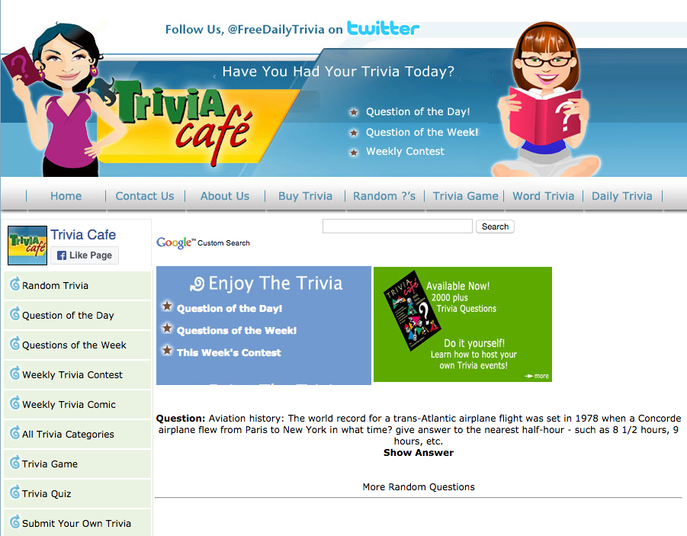
Existing Site
Tons of room for improvement.
Confusing navigation
Older CSS and Javascript
Not Mobile Friendly

Slide 3

Site Outline
Movies Trivia
Other Trivia
People Trivia
Phrase Trivia
Politics Trivia
Product Trivia
Pub Trivia
Radio Trivia
Religion Trivia
Science Trivia
Sports Trivia
Word Trivia
Trivia Categories
Animal Trivia
Arts Trivia
Computer Trivia
Currency Trivia
Current Event Trivia
Education Trivia
Entertainment Trivia
Fad Trivia
General Trivia
Geography Trivia
Government Trivia
History Trivia
Labor Trivia
Law Trivia
Mathematics Trivia
Home
Question of the Day
Questions of the Week
Weekly Trivia Contest
Submit Your Own Trivia
Trivia Categories
About
Contact
Plan Your Own Event
Trivia Book Info
Buy Trivia

Slide 4
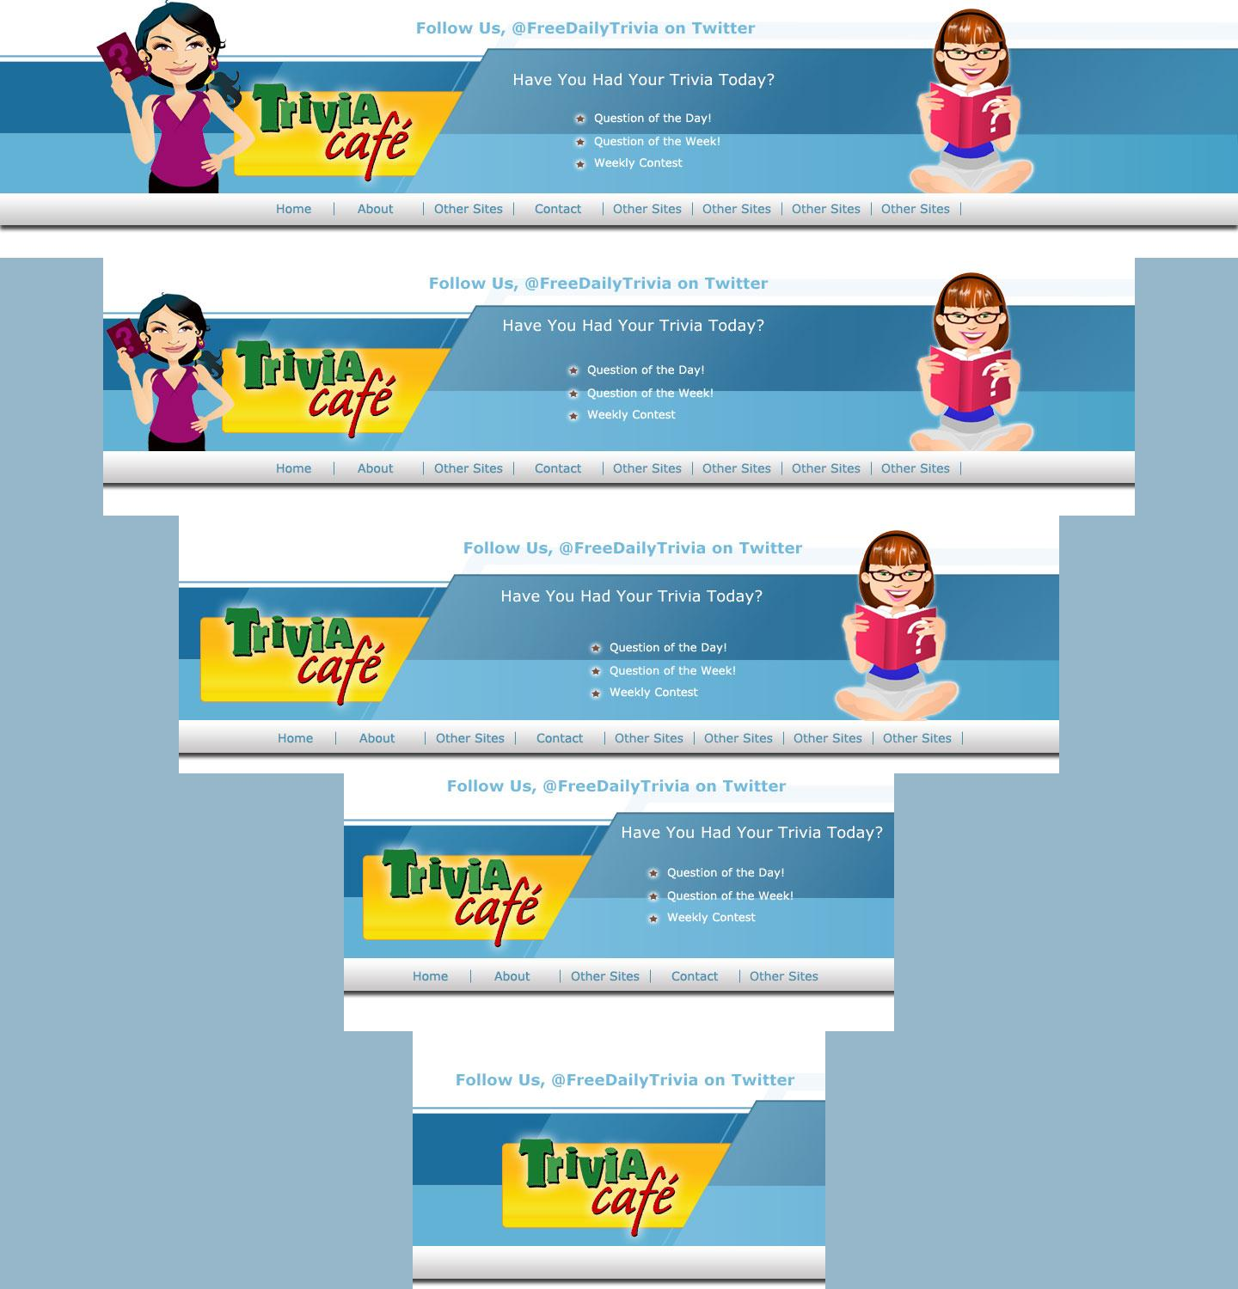
Responsive Design
By Setting up the Layout in Photoshop prior to coding, we can test layouts on different screen resolutions very quickly.
Some elements are only visible on larger screens.
As screen sizes decrease, real estate becomes a premium, so branding and call to action elements take precedence over visual elements.

Slide 5

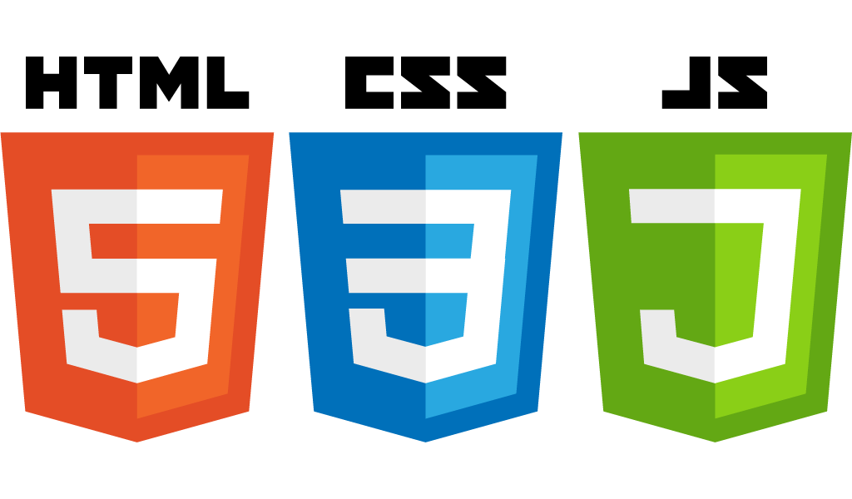


Tools:
Codebase:
PHP
Javascript
jQuery
SASS

Slide 6




Individual Tools
ِ
Almandub Komodo Edit 9 to design FileZilla Client Google Chrome on Windows Iphone 4.s | Bradford Coda for php IDE, includes SFTP client Adobe Photoshop CS Adobe Illustrator CS Firefox with Web Developer Toolbar and Firebug Github UI SourceTree | Sean Atom editor, Intellij Idea GitBash FileZilla Adobe Cloud (all products) Chrome with Devtools Samsung Note 7

Slide 7


Testing Plans
Testing devices
iPhone 4, iPad 3, iPad 2, Samsung Note 3 Tablet, Sony Laptop, Segway Gaming Laptop, Mac Mini, Macbook Air, Asus Laptop
Website Testing Tools
GT Metrix
https://gtmetrix.com/
Wave Accessibility Testing
http://wave.webaim.org/

Slide 8

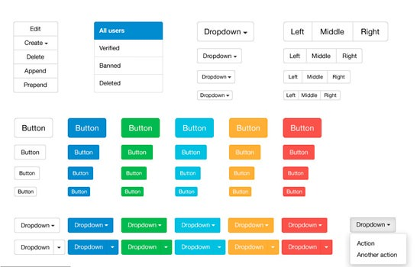
Design Elements
Bootstrap provides many great standardized ui elements which we will customize to fit the look and feel of the site better
Using SASS technology, we can compile optimized CSS, with our customization, into standard bootstrap class names.

Slide 9

Deployment Plan
Development Site
Commit changes to BitBucket
Trigger is fired from BitBucket to server
Server pulls newest commits into development site
Production Site
SFTP files up to production server, after testing complete

Slide 10

Non-Functional Specifications
Site must be fully responsive, user experience optimized
Site must be secure, filtering all user submitted details and preventing XSS
Site must be accessible for users of adaptive technology
Site must be optimized for fast and efficient loading on any connection
Site must be built using current web development best practices

Slide 11

Timeline - Stage One and Stage Two
Stage One - Site Update | Date | Stage Two - Game Update | Date
Meeting One | 10/2/2016 | Element Design | 10/21/16 - 10/25/16
Project Presentation 1 | 10/4/16 - 10/10/16 | Game UI Design | 10/26/16 - 10/30/16
Page Layout | 10/12/16 - 10/15/16 | Game Coding | 10/31/16 - 11/5/16
CSS Framework | 10/16/16 - 10/19/16 | Responsive Game Testing | 11/6/16 - 11/8/16
Meeting Two | 10/20/16 | Meeting Three | 11/9/16

Slide 12
Timeline - Stage Three and Stage Four
Stage Three - Database Connection | Date | Stage Four - Testing | Date
Database Setup | 11/10/16 - 11/12/16 | Responsive Testing | 11/17/16 - 11/22/16
Database Migration | 11/13/16 - 11/15/16 | User Testing | 11/23/16 - 11/28/16
Meeting Four | 11/16/16 | Meeting Five | 11/29/16
 |  | Final Corrections | 11/30/16 - 12/1/16
 |  | Meeting Six | 12/2/16

Slide 13
Timeline - Stage Five
Stage Five - Deliverables | Date
Project Presentation 2 | 12/3/16 - 12/4/16
Meeting Seven | 12/5/16
Project Turn in | 12/12/16

Slide 14

Contributions Thus Far:
Almandub Installation of codebase Determination of timeline goals Creation of Presentation 1 Learning Git, node.js, Sass, ect. | Bradford Provided codebase, site materials Provided repo, documenting software Determination of timeline goals Creation of Presentation 1 | Sean Installation of codebase Determination of timeline goals Recordkeeper, documentation write up Creation of Presentation 1

Slide 15

Conclusion
Overall we aim to deliver a unique trivia experience accessible regardless of platform or device that showcases a modern design that is sleek and intuitive, letting the quality content speak for itself.
Users should be able to focus on learning and fun, rather than navigating an outdated and confusing interface.

